Slide 1
Telangana Tourism Data Analysis
A. Avanthika
Source: https://data.telangana.gov.in/dataset/tourism-visitors-data
Dataset: Tourism_data
Email: avanthikasharma11@gmail.com
Phone: 9032018746
GitHub: https://github.com/Avanthikaa11/BigDataAnalytics
LinkedIn: https://www.linkedin.com/in/avanthika-adhirajapalli-85433226a/

Slide 2
Introduction
This presentation provides a detailed analysis of Telangana’s tourism trends using visitor count data collected from 2018 through Winter season.
It highlights district-wise performance, seasonal variations, monthly trends, and data-driven recommendations.
The project aims to assist tourism authorities in understanding visitor patterns, optimizing resources, and improving regional tourism planning.

Slide 3
Dataset Description
Source: Tourism_data.csv
Records: 8,489 | Columns: 5
Columns Overview:
District: Name of the district in Telangana
Month: Month of record
Visitors: Number of visitors in that district and month
Year: Year of observation
Season: Categorized as Summer, Monsoon, Autumn, or Winter

Slide 4
Data Quality
No Missing Values: Dataset verified to contain no null or blank entries across all fields.
Uniform Data Types: All numeric fields (like Visitors) are stored as integers, enabling accurate aggregation and statistical operations.
Categorical Accuracy: Seasons are mapped correctly to corresponding months (e.g., Summer → April–June).
Ready for Visualization: The dataset is clean, structured, and directly compatible with Python and PySpark visual analytics tools.
Validated Data Source: Data aligns with Telangana tourism records, ensuring analytical reliability.

Slide 5
Data Exploration & Operations
Data Loading & Inspection:
Imported Tourism_data.csv into a Pandas DataFrame and a PySpark DataFrame for distributed processing.
Descriptive Statistics:
Total visitors: 715,410,282
Average visitors per record: 84,275
Data Aggregation:
Grouped data by District to find top-performing tourism zones.
Aggregated by Season to understand seasonal tourism peaks.
Aggregated by Month to observe intra-year fluctuations.
Visualization:
Used Matplotlib and PySpark to create bar charts, heatmaps, and line plots for district-wise, seasonal, and monthly visitor patterns.

Slide 6
Methodolgy / workflow
Data Loading:
Imported the raw dataset into Python and PySpark environments for inspection and processing.
Data Cleaning & Quality Check:
Ensured data consistency, verified schema, and removed any irregularities.
Exploratory Data Analysis (EDA):
Displayed initial samples of records.
Explored patterns across districts, months, and seasons.
Grouped data by key attributes such as district and season.
Visualization:
Created heatmaps for district-season patterns.
Developed line and bar graphs to represent monthly and yearly trends.
Insight Extraction:
Identified top districts and months.
Compared seasonal performance.

Slide 7
Key Insights
District-Level Trends
Total visitors recorded: 715,410,282
Average per observation: 84,275
Top 5 Districts:
Mulugu – 77,297,381
Hyderabad, Ranga Reddy, Medchal & Vikarabad – 61,325,331
Yadadri Bhongir – 49,289,828
Rajanna Sircilla – 44,543,745
Hyderabad – 43,239,548
Interpretation:
Mulugu emerges as the most visited district, likely due to its natural attractions like waterfalls and temples. Urban centers such as Hyderabad and Ranga Reddy maintain high consistent visitor volumes due to business and leisure tourism.

Slide 8
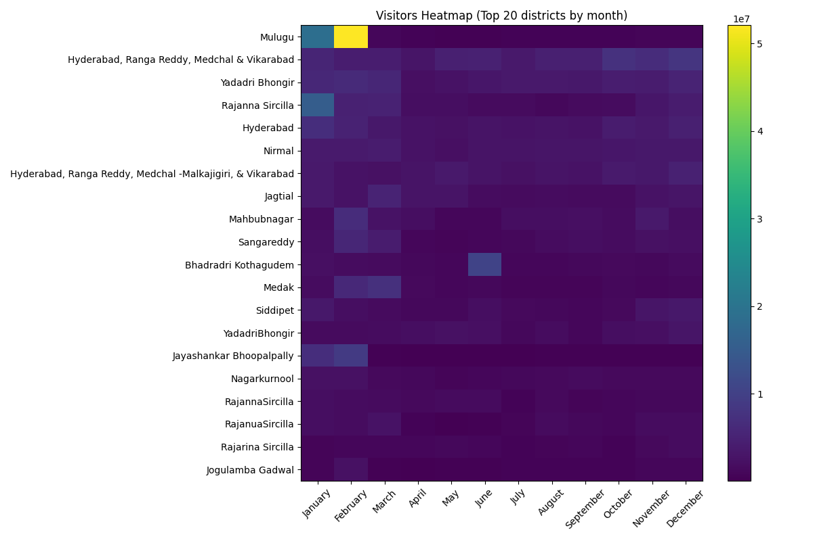

Slide 9
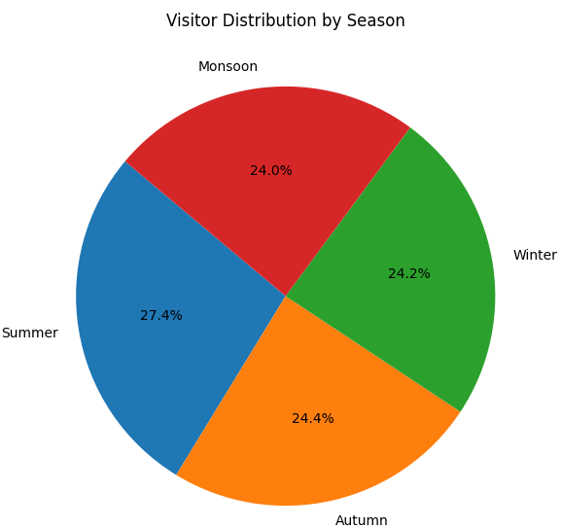
Seasonal Patterns
Summer: 196,004,551 visitors (highest)
Autumn: 174,939,935 visitors
Winter: 172,453,632 visitors
Monsoon: 172,012,162 visitors
Interpretation:
The summer season dominates tourism, possibly due to school holidays and temple festival timings.Autumn and winter show balanced inflow, indicating consistent off-peak visitation patterns suitable for year-round tourism planning.

Slide 10
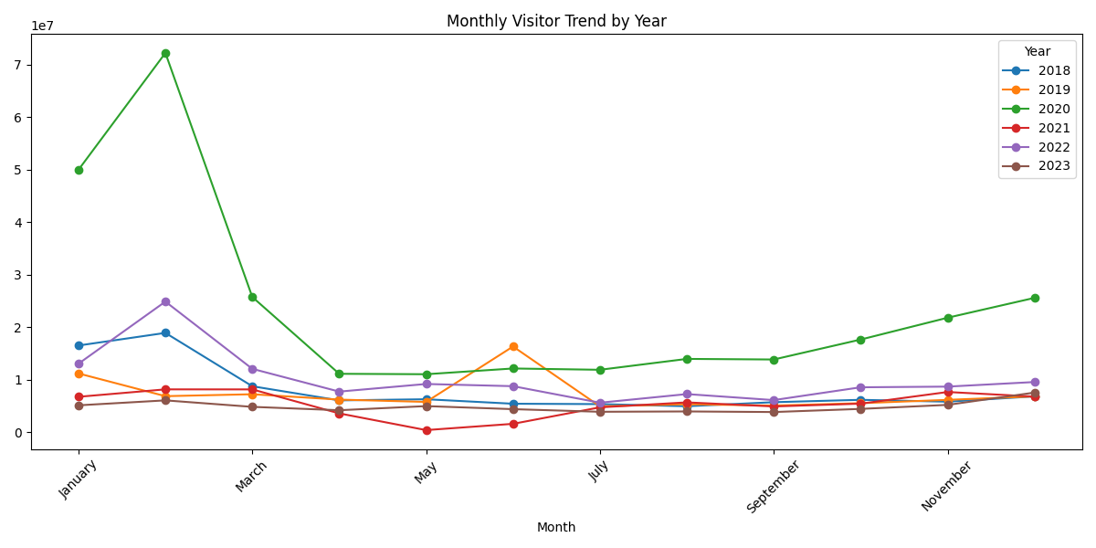
Monthly Trends
Top-performing months: February, January, March, December, November
These months align with festive seasons and pleasant weather in Telangana.
Mid-year months show moderate travel, likely affected by weather conditions and academic schedules.
Interpretation:
Monthly data shows a peaks in early and late months of the year.
This suggests targeted promotions during low-traffic months (May–August) could balance annual visitor distribution.

Slide 11
Key Findings
Telangana recorded a total of 715 million visitors, with an average of 84,275 visitors.
Top Districts:
Mulugu leads as the most visited district (77 million visitors).
Hyderabad, Ranga Reddy, Medchal, and Vikarabad follow with high urban tourism inflows.
Seasonal Insights:
Summer had the highest visitor count (196 million).
Autumn and Winter followed closely with balanced tourism rates. Monsoon saw a slight decline, likely due to weather conditions.
Monthly Trends:
Peak months: February, January, March, December, and November.
Indicates strong tourism during festive and cooler months.
Predictable Patterns:
The dataset reveals clear seasonal cycles, making it highly suitable for time-series forecasting models.

Slide 12
Recommendations
Focus on top-performing districts
Promote during low-average months
Create dashboards for monitoring
Build predictive models for forecasting
Future Analytics Opportunities
Develop time-series forecasting models
Cluster districts by visitation patterns
Integrate external data (weather, events, transport)

Slide 13
Conclusion
The tourism data analysis successfully identifies the patterns connecting district, season, and month-wise visitor trends.
The clean dataset allowed reliable aggregation, supporting effective decision-making.
This study lays the foundation for predictive analytics, digital dashboards, and strategic tourism development across Telangana.

